Slide 1


AtliQ Hardware Finance & Supply Chain Analytics

Slide 2
Problem Statement -
As the size of our Excel files continues to grow, we are encountering performance issues, causing them to become unresponsive and inefficient. To address this challenge, AtliQ Hardware has initiated a project to incorporate a team of data analysts who will use MySQL as their database management system and to extract valuable insights from the data. These insights will empower our company to make more informed and strategic decisions, ultimately optimizing our operations and performance.

Slide 3
Data Sets -
dim_customer
Dim_Product
Fact_sales_monthly
Gdb0041 (Database)
Fact_forecast_monthly
Tables
Fact_gross_price
Click here to download the database File.
Fact_pre_invoice_deductions
Net Invoice Sales
Fact_post_invoice_ deductions
Net Sales
Fact_freight_cost
Fact_manufacturing_cost
GM

Slide 4
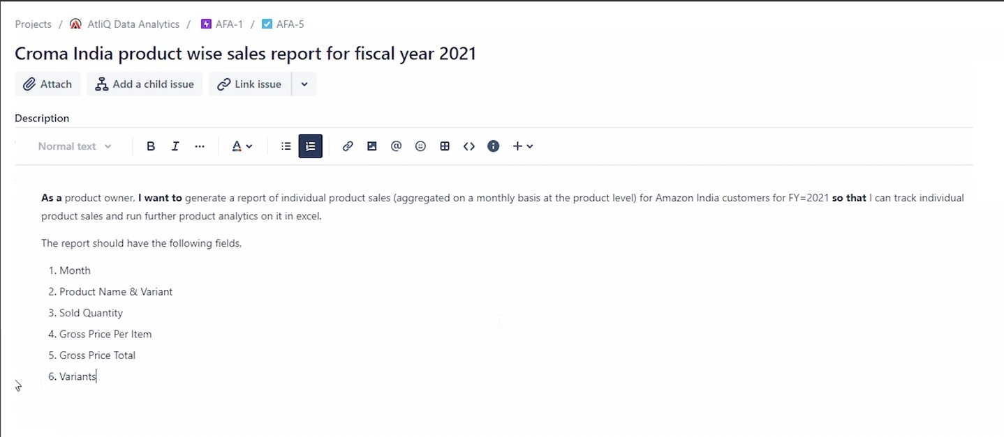
1.
Click here to download the Query file.

Slide 5
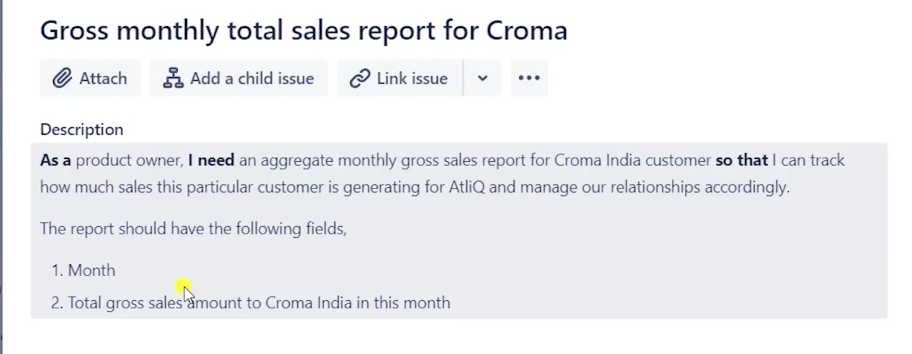
2.
Click here to download the file

Slide 6
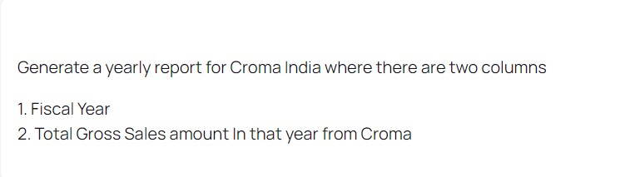
3.
Click here to download the file

Slide 7
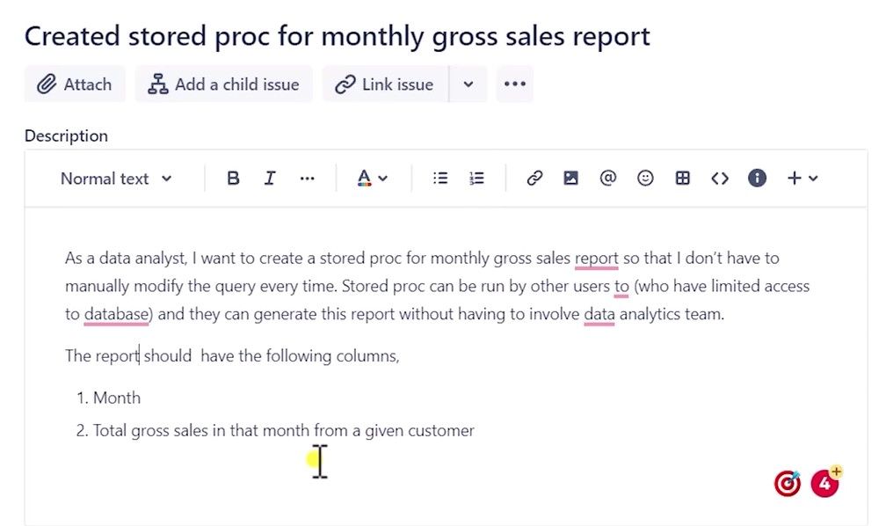
4.
Click here to download the file

Slide 8
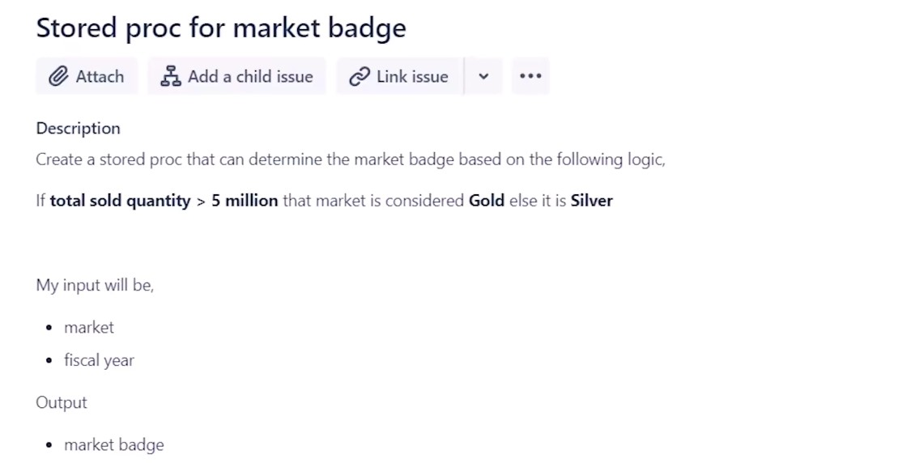
5.
Click here to download the file

Slide 9
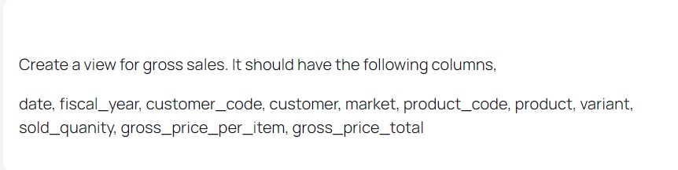
6.
Click here to download the file

Slide 10

7.
Click here to download the NS view File
Click here to download Top customers by NS file
Click here to download Top Market by NS file
Click here to download Top Product by NS file

Slide 11
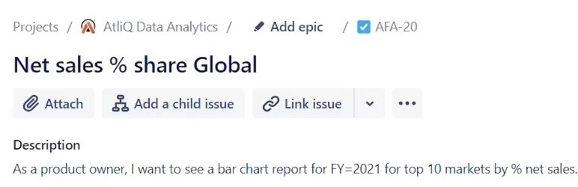
8.
Click here to download the SQL file
Click here to download the Excel File report

Slide 12
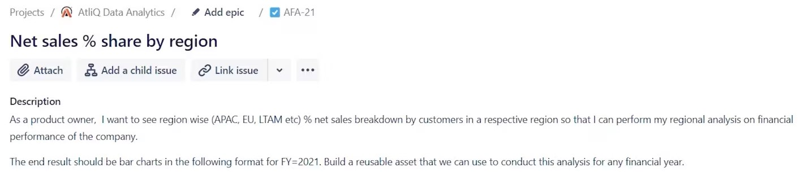
9.
Click here to download the SQL file
Click here to download the Excel file Report

Slide 13
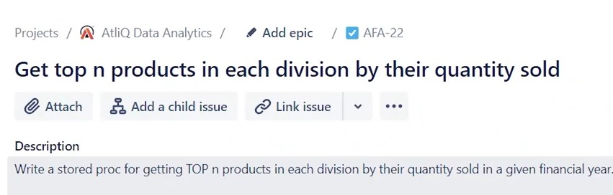
10.
Click here to download the file

Slide 14
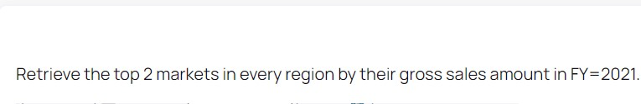
11.
Click here to download the file

Slide 15
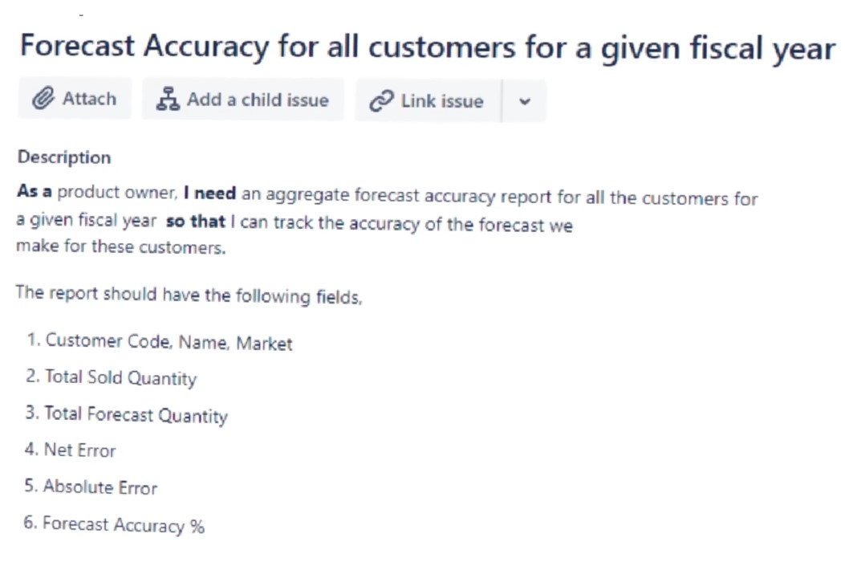
12.
Click here to download the file

Slide 16
13.
Click here to download the solution using CTE
Click here to download the solution using Temporary Table

Slide 17
Thanks

